Slide 1


INDUSTRIAL COMBUSTION ENERGY USE
PRESENTED BY:
GROUP 2
1. MD TABISH MAHTAB 2. THARUN DOMMETI
3. HEMAA NANDINI. P 4. SHILNA VYSHAK
5. LAXMAN KUMAR 6. HEMANTH DHAKED
7. MANISH DANGE 8. PRANjALI

Slide 2
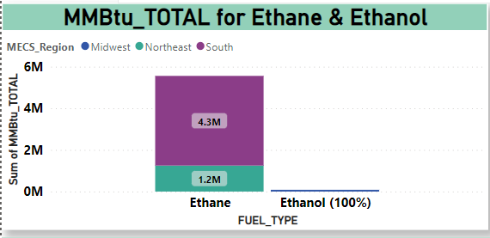
Ethane & ethanol’s mmbtU’S TOTAL:
Ethanol is the only source for Midwest region while Northeast and South uses Ethane.
MONT BELVIEU FRACTIONATORS facility is highest ethane consumer.
The Dove Company is the only company that uses ethanol as fuel.
Ethanol and Ethane are processed through process heater and other combustion source unit type.
STATES | % MMBtu by ethane and ethanol
TEXAS | 76.38%
PENNSYLIVINIA | 22.13%
MICHIGIN | 1.48%

Slide 3
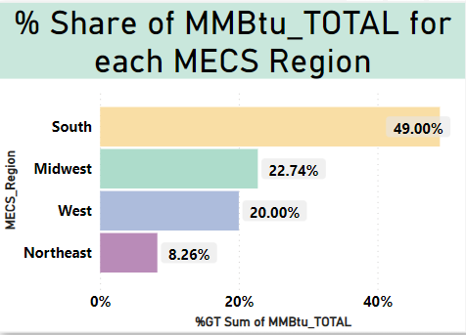
% Share of MMBtu_Total for each MECS Region:
South region has highest MMBtu total of 49%.
Midwest remains with 22.74% share in MMBtu consumption.
Texas and Louisiana states are top 2 consumers from south region.
Least MMBtu usage is by Vermont state of Northeast
West region has 20% of share in MMBtu energy
Northeast utilized only 8.26% of energy

Slide 4
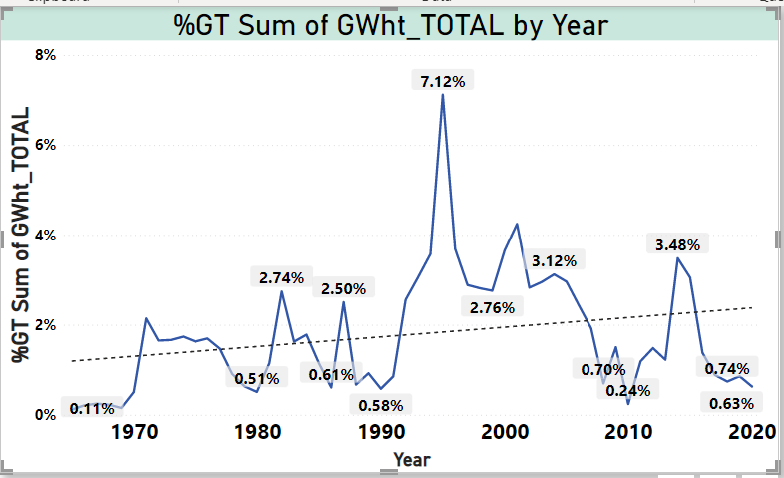
Trend Analysis of GWht_ Total:
The GWht total usage over the time period of 1965 is 0.11% to 2030 is 0.63%.
The maximum GWht total usage is 221K in 1995.A
There is a drastic increase in Gwht usage in 1990-2000.
Nature gas is the fuel that helps in producing the Highest GWht production over the years
Finally , we can observe that the trend of Gwht is increasing every decade.

Slide 5
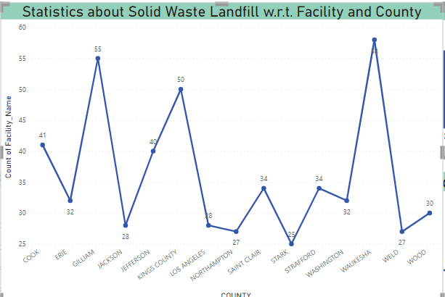
Statistics about Solid Waste Landfill w.r.t Facility and County:
Waukesha County is the top county in using solid waste landfilling as a NAICS with respect to Facility Count of 58.
Administration and support and Waste Management and Remediation services are dealing with Solid waste Land Filling
2048 Facilities are involved in Solid waste landfilling as primary NAICS.
40% facilities are using Comfort Heaters in fuel combustion which contributes in solid waste landfilling.

Slide 6
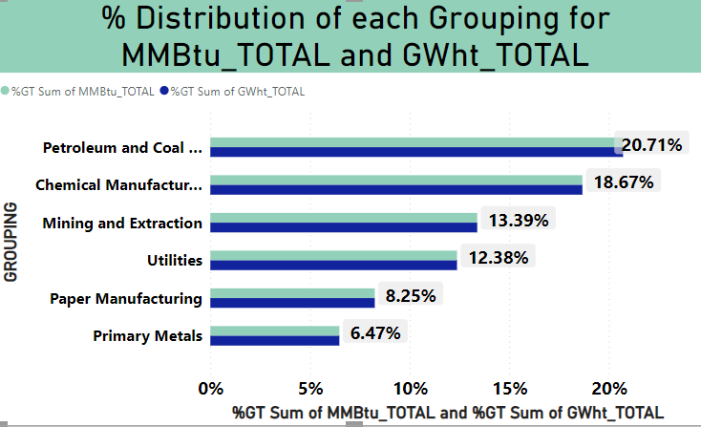
% Distribution of each Grouping for MMBtu_total & GWht_Total
Petroleum and Coal products contributed 20.71% in MMBtu and GWht_ Total
While primary Metals group utilized only 6.47% of Fuels
28 different groups are utilizing fuels as energy
Average usage of MMBtu is 525.43K
Average usage of GWht_Total is 153.99

Slide 7
THANK YOU

